Slide 1
Benchmark NLP
Resultados reais extraídos dos CSVs

Slide 2
Resumo
Conjunto Total Resolvidos Taxa_%
AMPL NLP 97 44 45.36
MadNLP 22 21 95.45
COCONUT 159 159 100.00

Slide 3
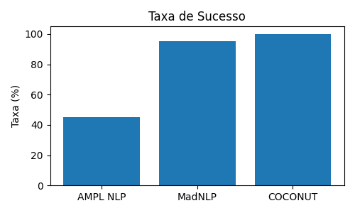
Taxa de Sucesso

